Slide 1

rthrtgtg
ОБЗОР РЫНКА ФАСТФУД-РЕСТОРАНОВ НЕКОТОРЫХ ГОРОДОВ США ДЛЯ
СТАРТАПА
Columbus, Ohio
Cincinnati, Ohio
Cleveland, Ohio
Las Vegas, Nevada
Miami, Florida.
Indianapolis, Indiana
Birmingham, Alabama
Portland, Oregon

Slide 2
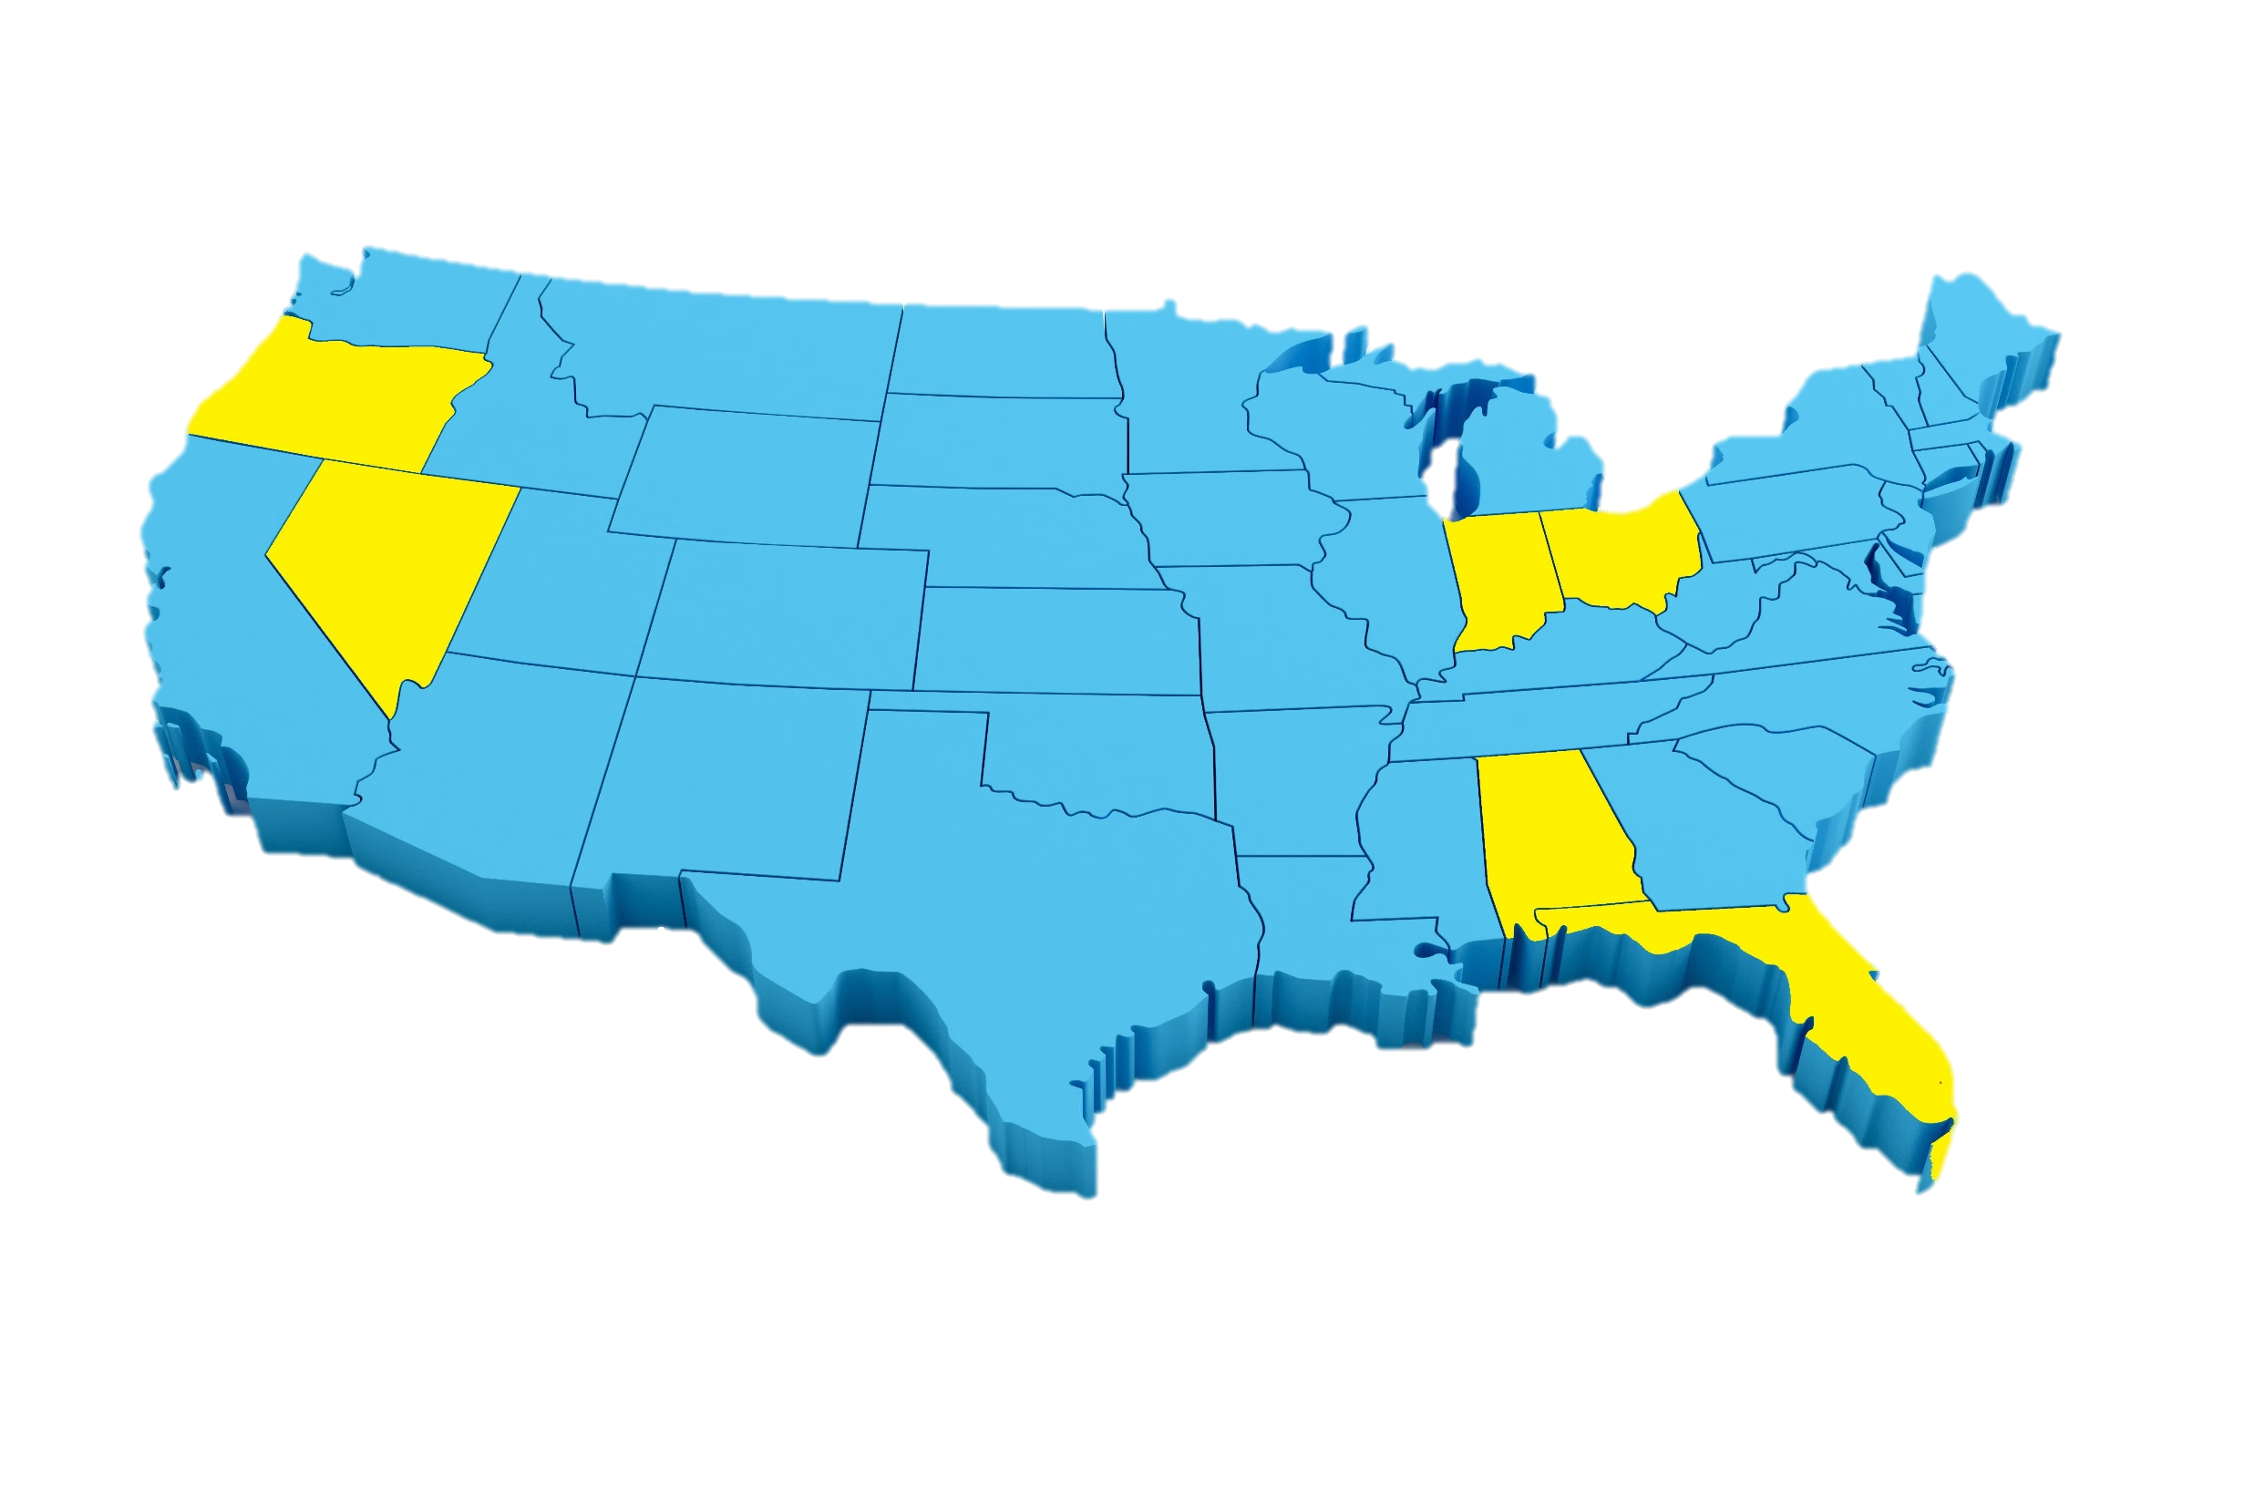

Portland
Review
Indianapolis
Oregon
Ohio
Indiana
Unit economics
Nevada
Cleveland
Columbus
Cincinnati
Alabama
Analytics
Florida
Las Vegas
Summaries
Birmingham
Miami

Slide 3
Portland
Review
Indianapolis
Oregon
Ohio
Indiana
Unit economics
Nevada
Cleveland
Columbus
Cincinnati
Alabama
Analytics
Florida
Las Vegas
Summaries
Birmingham
Miami

Slide 4
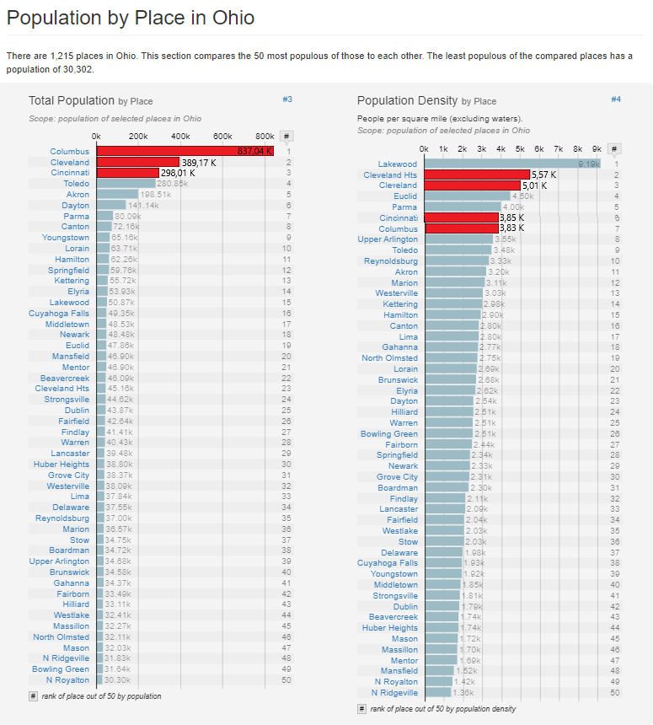
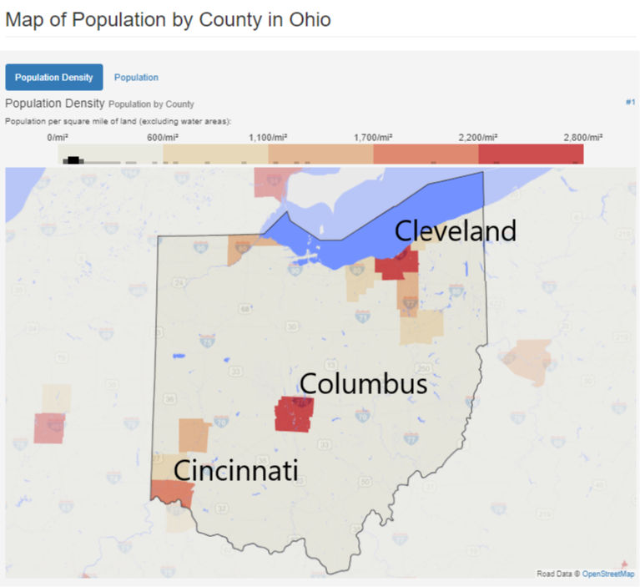
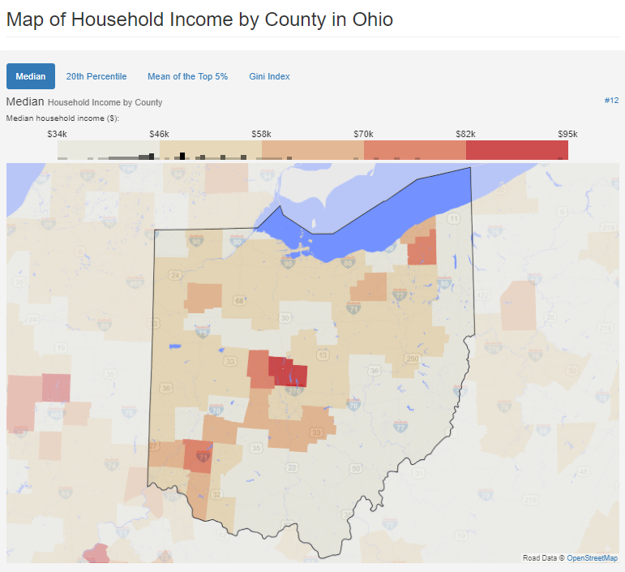
Portland
Review
Indianapolis
Oregon
Ohio
Indiana
Unit economics
Nevada
Cleveland
Columbus
Cincinnati
Alabama
Analytics
Florida
Las Vegas
Summaries
Birmingham
Miami

Slide 5
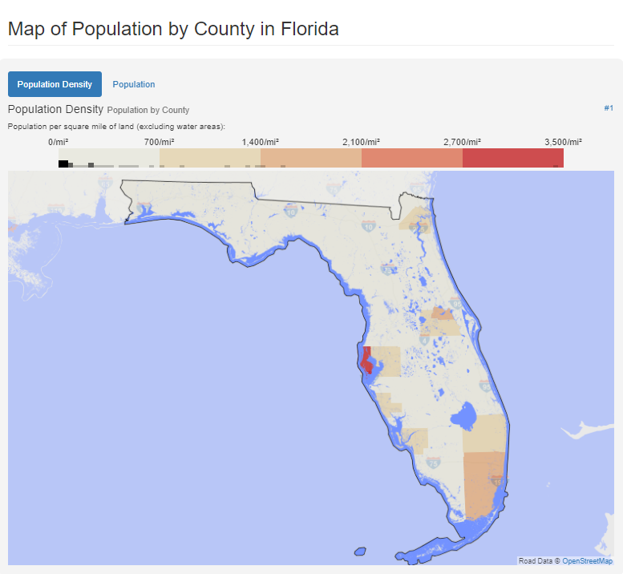
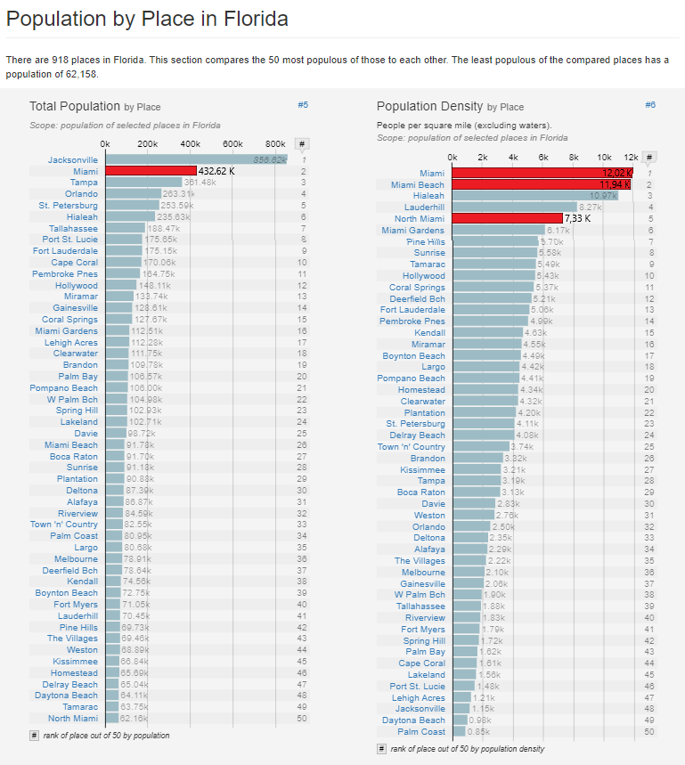
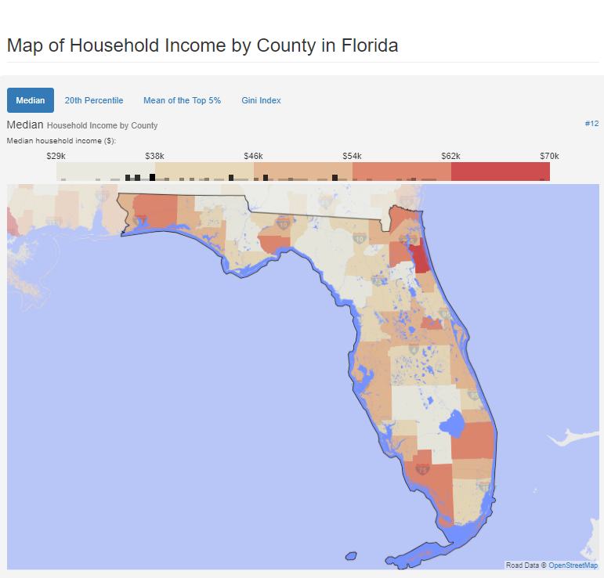
Portland
Review
Indianapolis
Oregon
Ohio
Indiana
Unit economics
Nevada
Cleveland
Columbus
Cincinnati
Alabama
Analytics
Florida
Las Vegas
Summaries
Birmingham
Miami

Slide 6
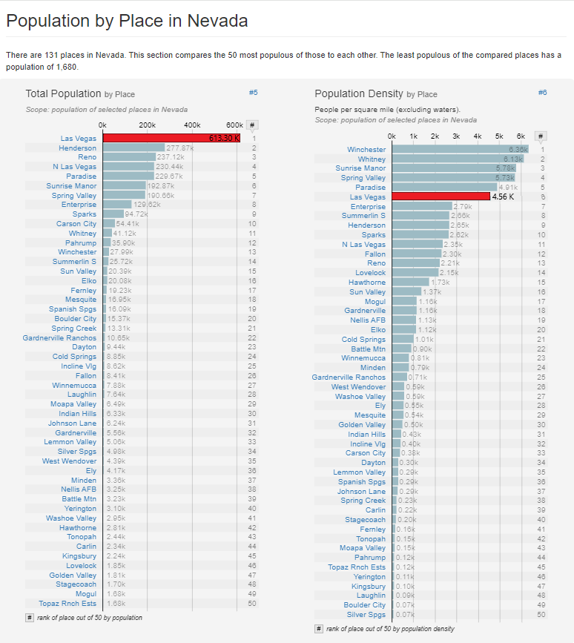
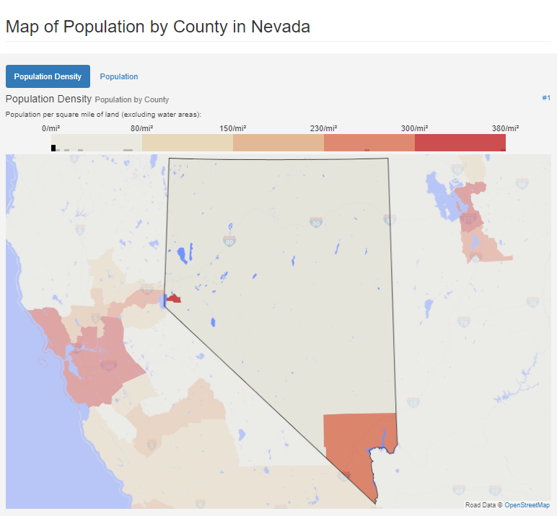
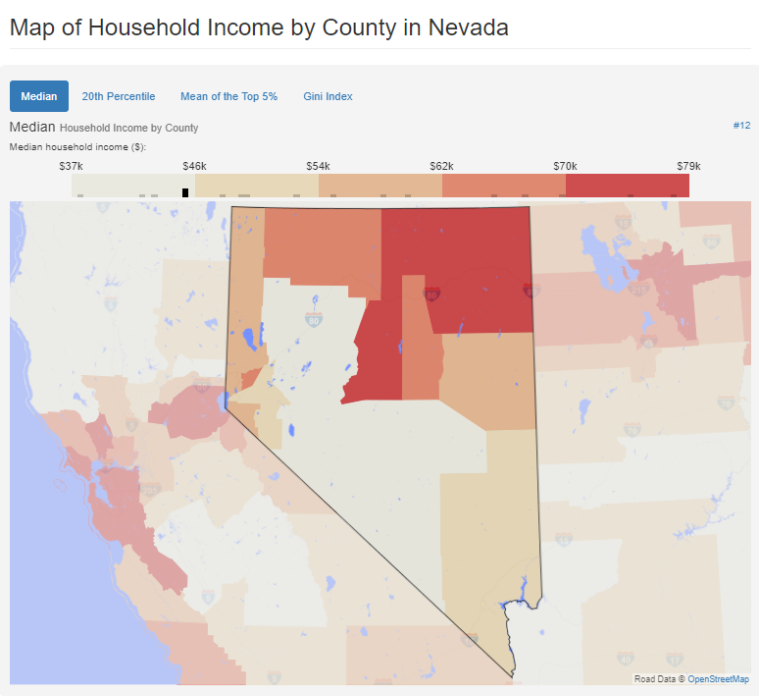
Portland
Review
Indianapolis
Oregon
Ohio
Indiana
Unit economics
Nevada
Cleveland
Columbus
Cincinnati
Alabama
Analytics
Florida
Las Vegas
Summaries
Birmingham
Miami

Slide 7
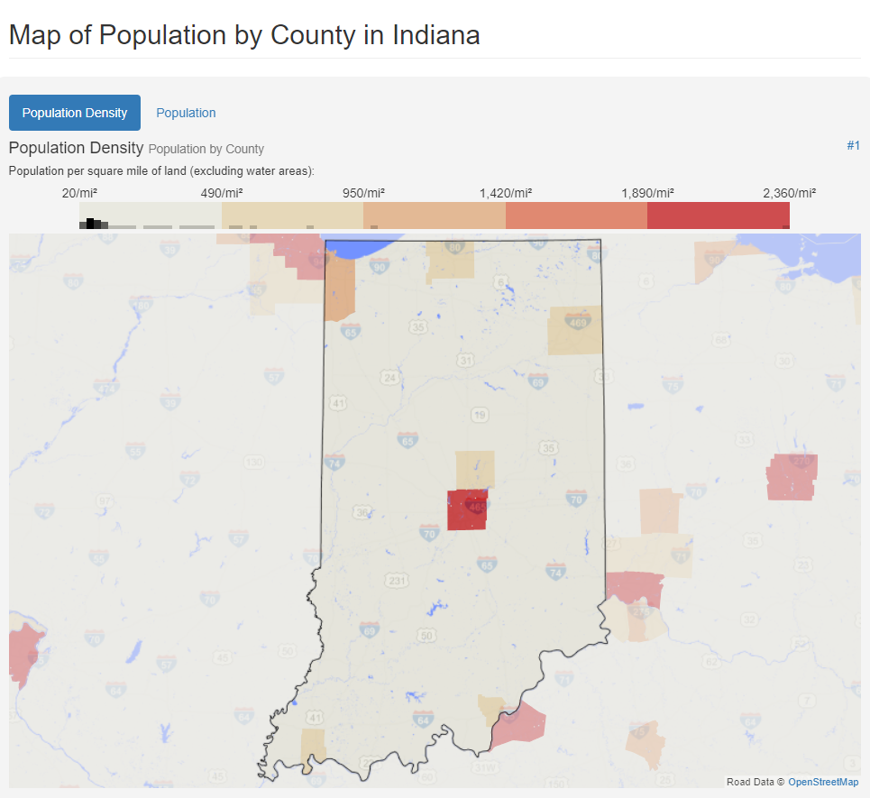
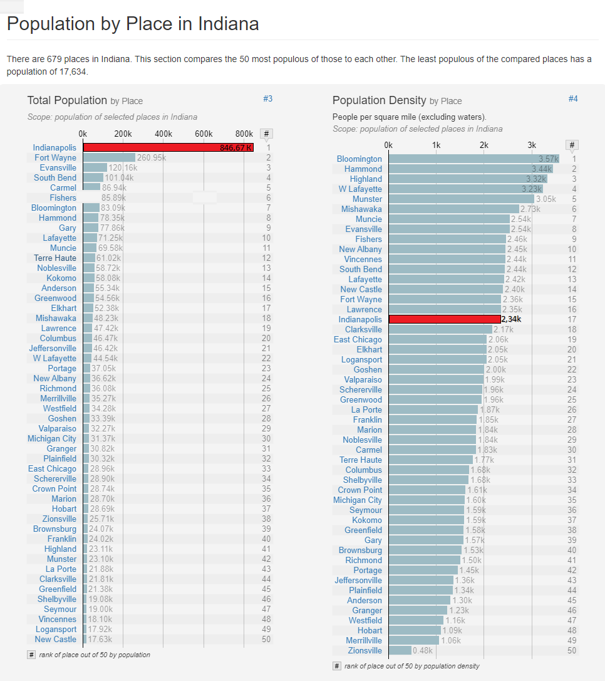
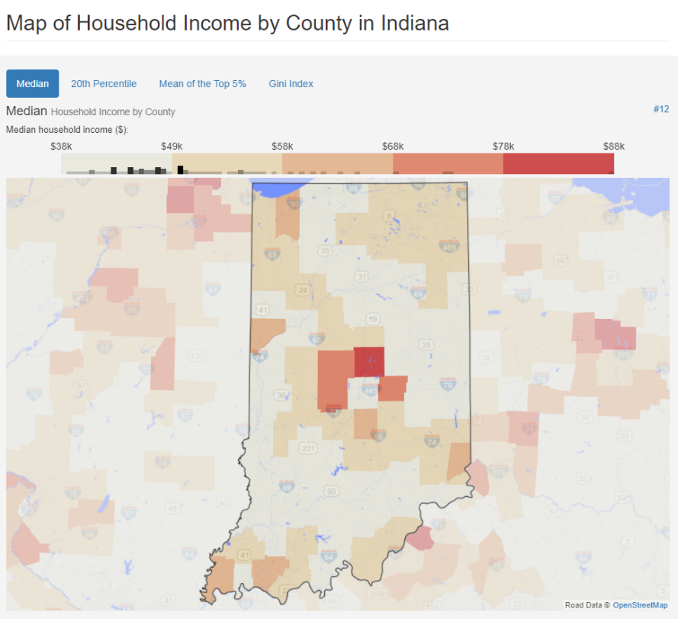
Portland
Review
Indianapolis
Oregon
Ohio
Indiana
Unit economics
Nevada
Cleveland
Columbus
Cincinnati
Alabama
Analytics
Florida
Las Vegas
Summaries
Birmingham
Miami

Slide 8
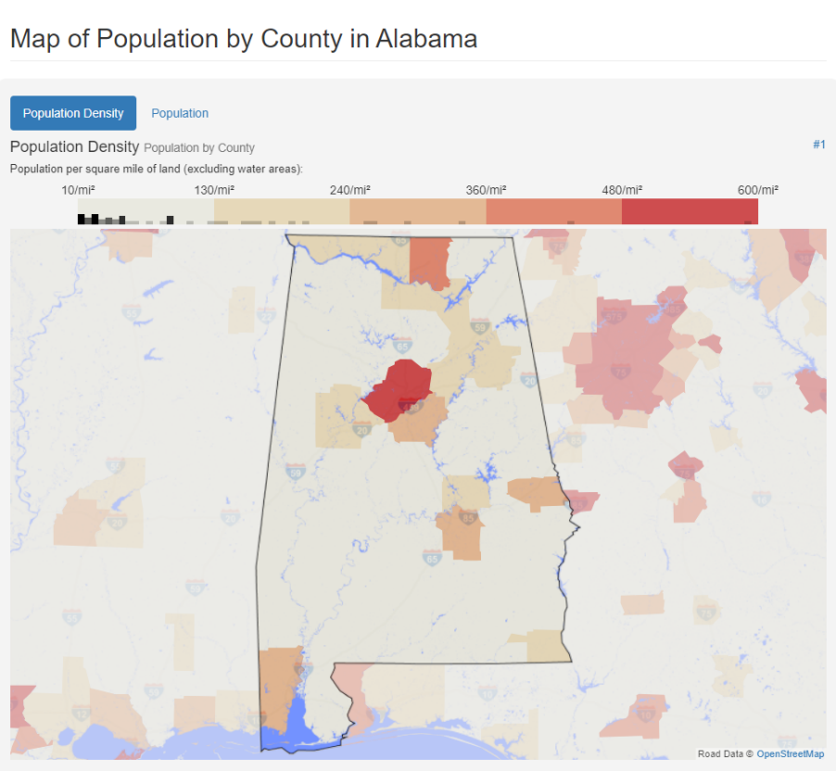
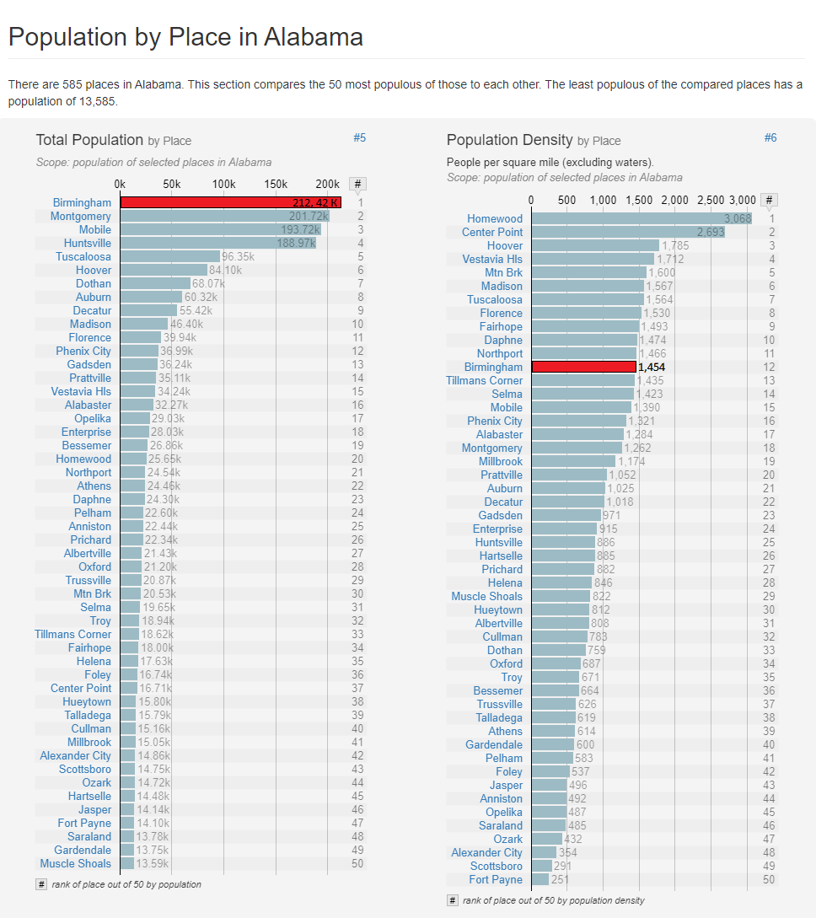
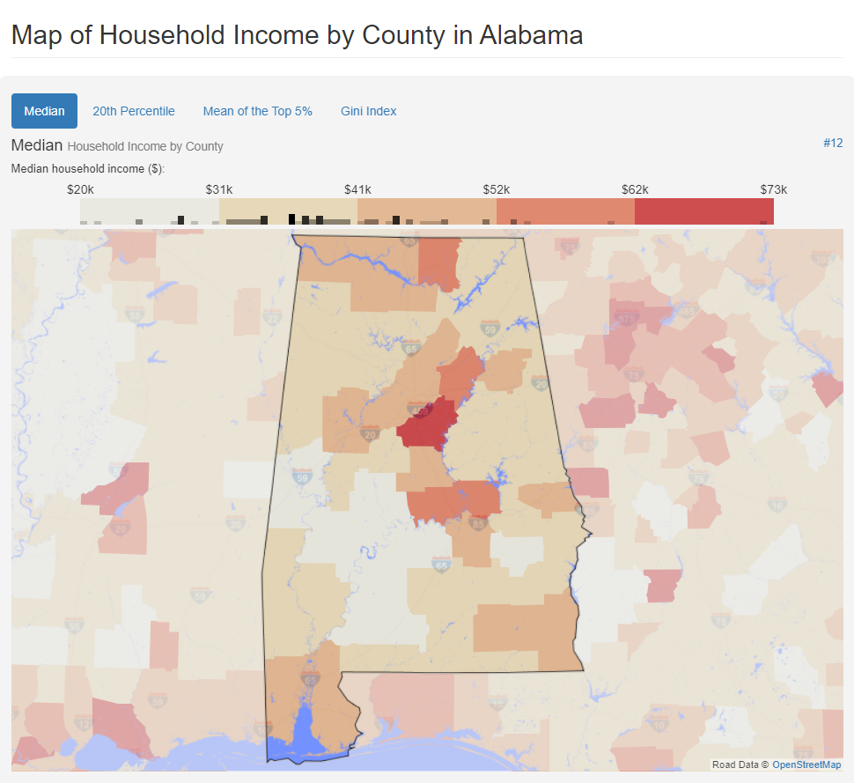
Portland
Review
Indianapolis
Oregon
Ohio
Indiana
Unit economics
Nevada
Cleveland
Columbus
Cincinnati
Alabama
Analytics
Florida
Las Vegas
Summaries
Birmingham
Miami

Slide 9
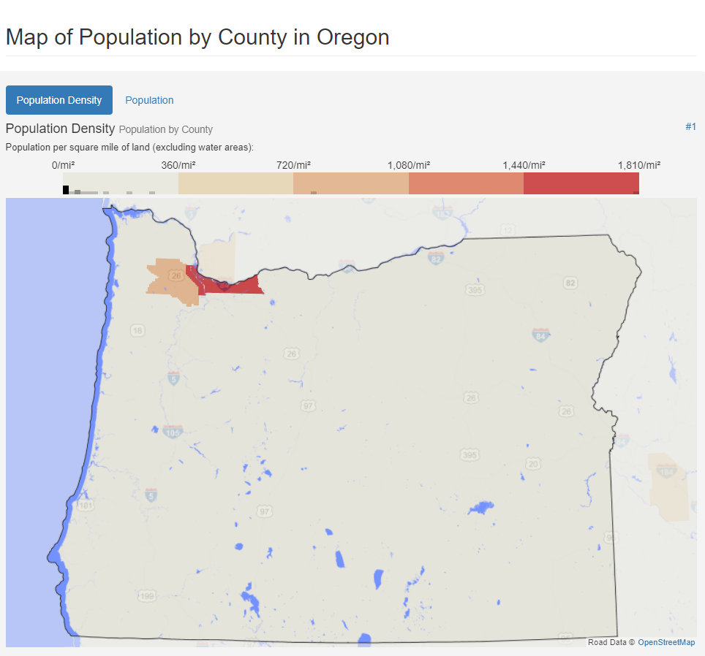
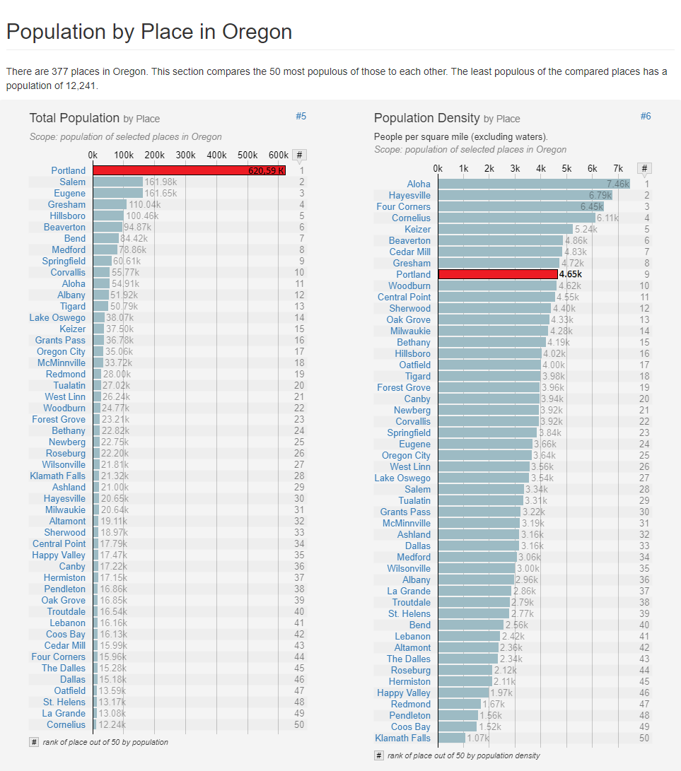
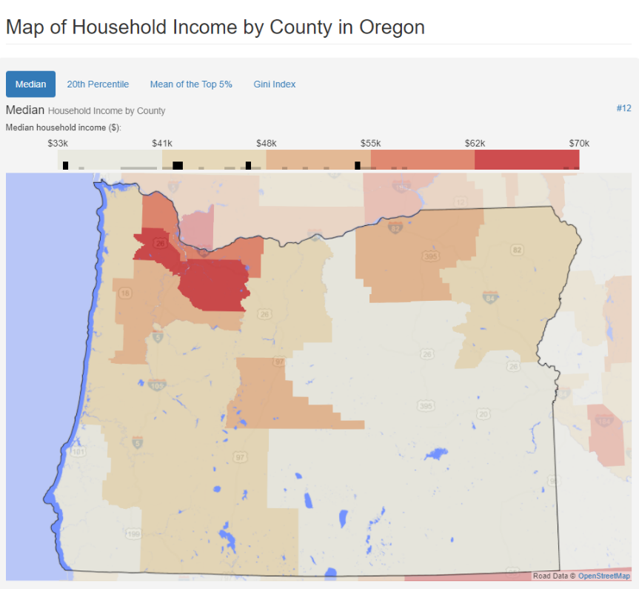
Portland
Review
Indianapolis
Oregon
Ohio
Indiana
Unit economics
Nevada
Cleveland
Columbus
Cincinnati
Alabama
Analytics
Florida
Las Vegas
Summaries
Birmingham
Miami

Slide 10
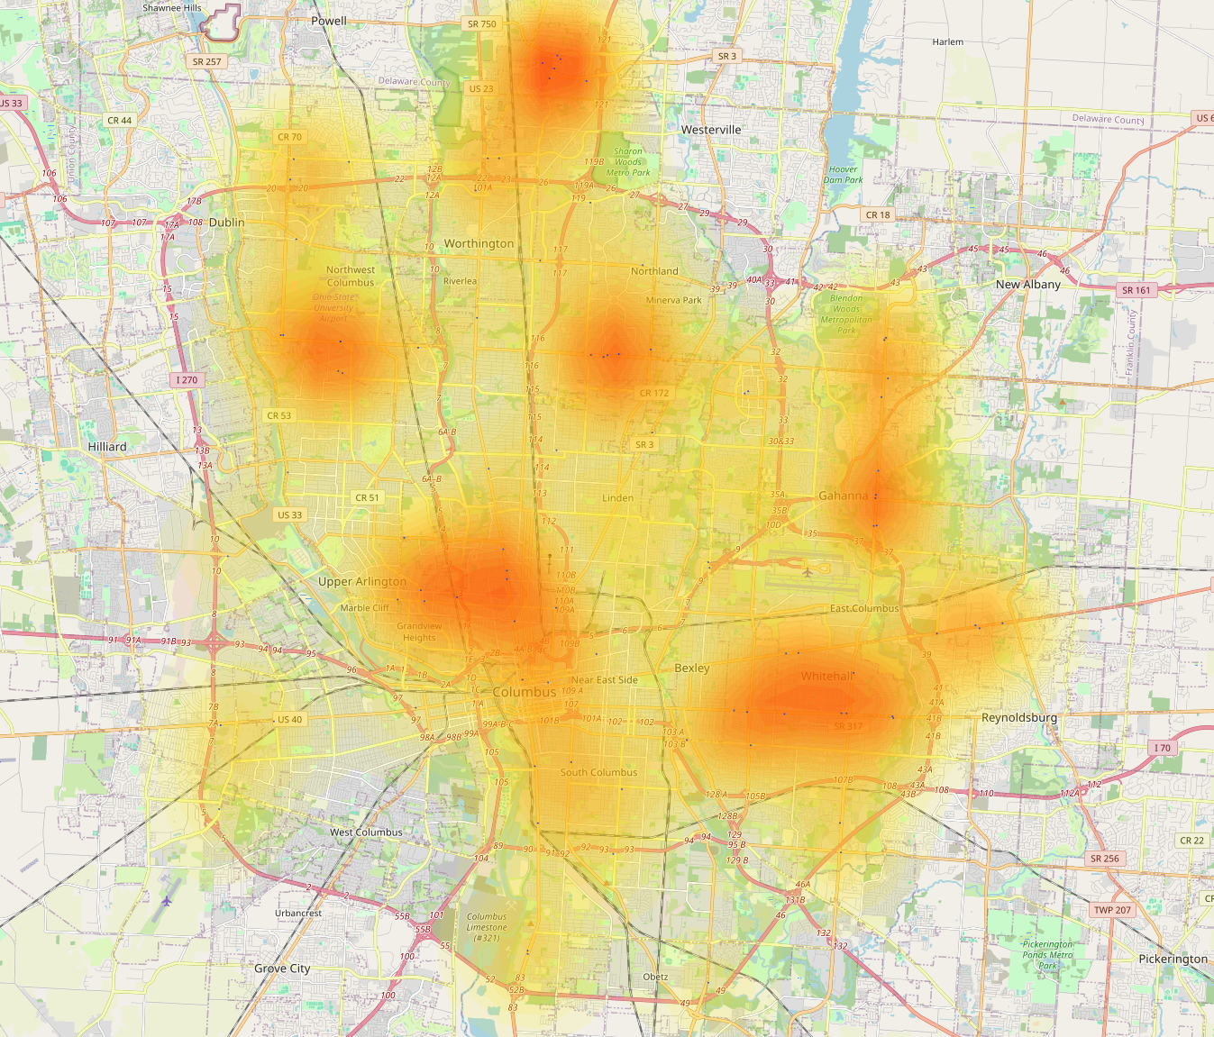
Columbus, Ohio
Portland
Review
Indianapolis
Oregon
Ohio
Indiana
Unit economics
Nevada
Cleveland
Columbus
Cincinnati
Alabama
Analytics
Florida
Las Vegas
Summaries
Birmingham
Miami

Slide 11
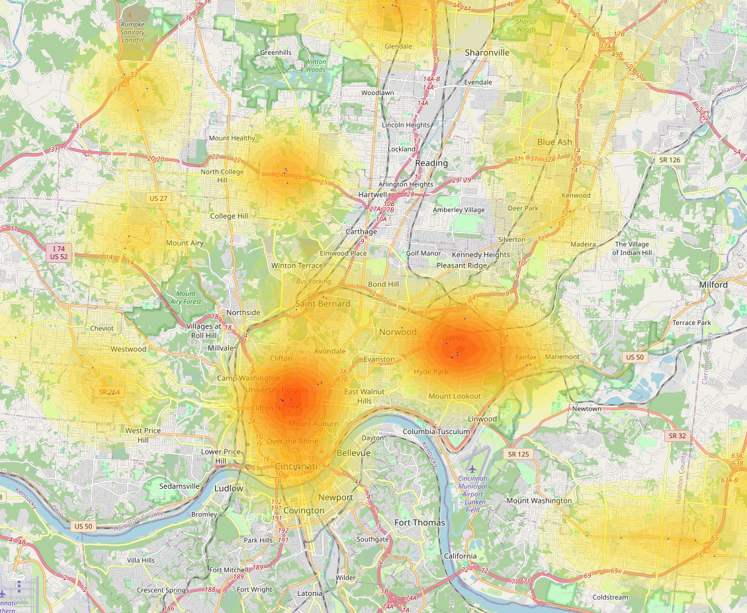
Cincinnati, Ohio
Review
Unit economics
Analytics
Summaries

Slide 12
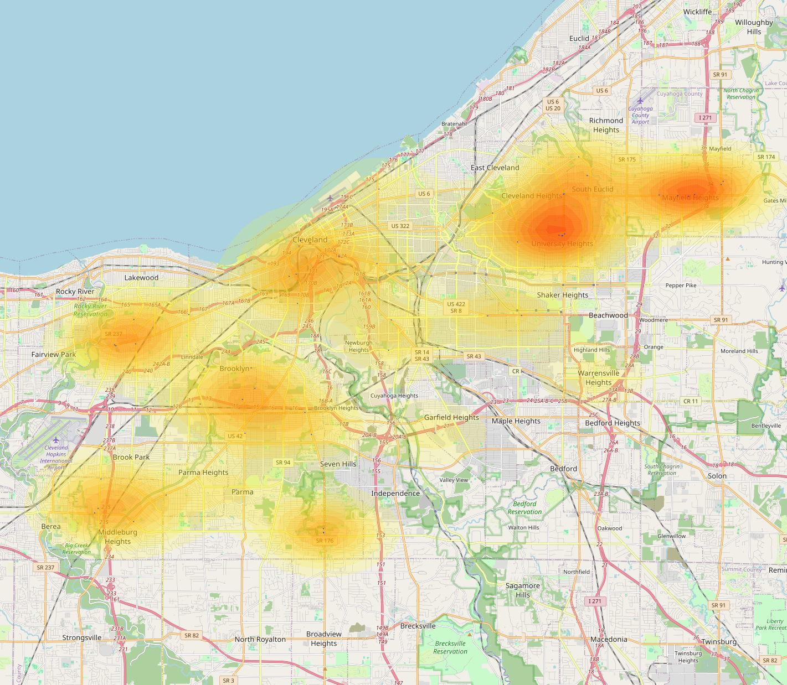
Cleveland, Ohio
Review
Unit economics
Analytics
Summaries

Slide 13
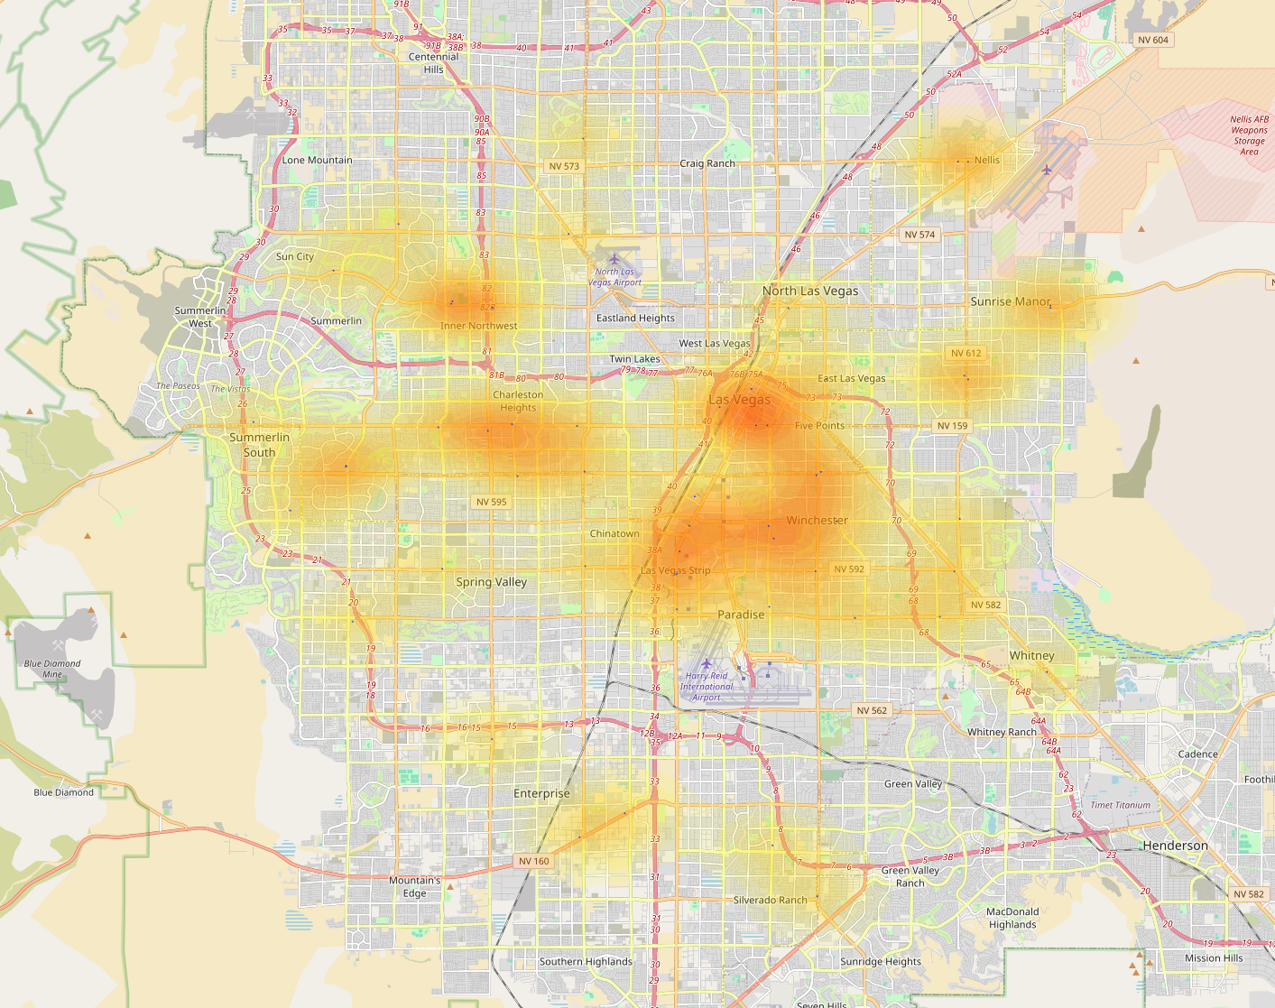
Las Vegas, Nevada
Review
Unit economics
Analytics
Summaries

Slide 14
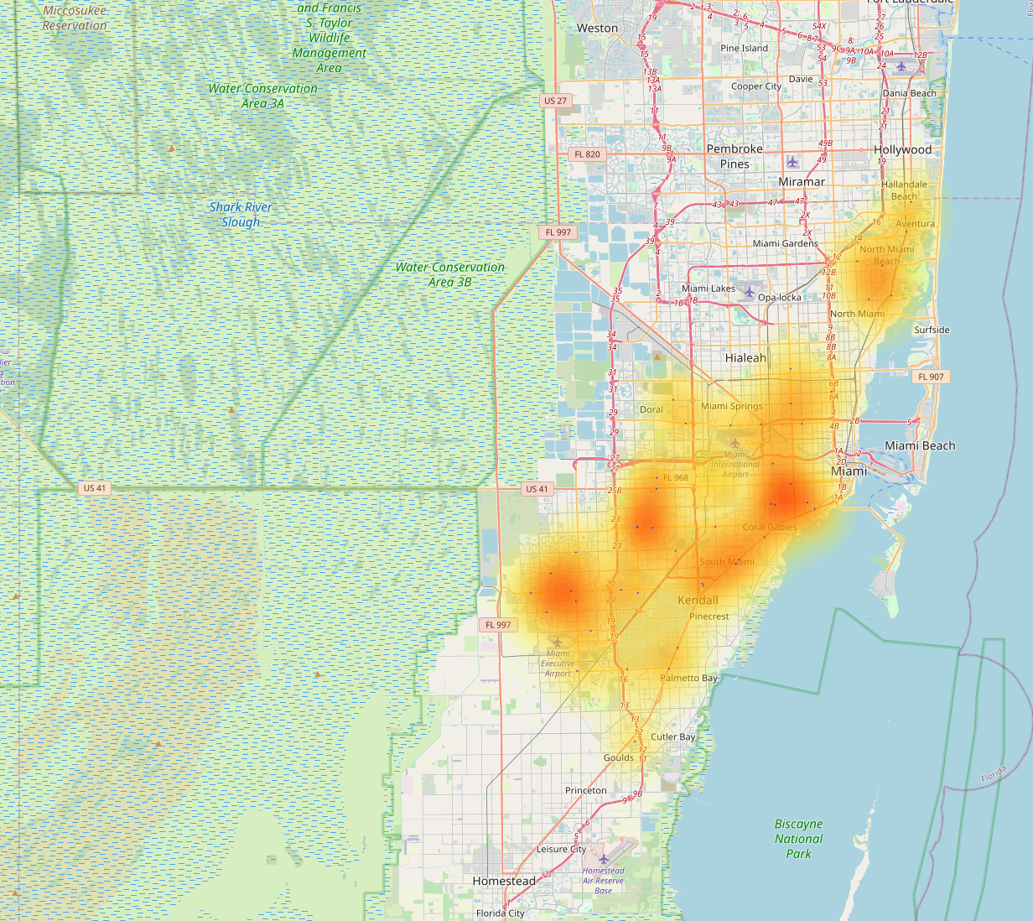
Miami, Florida.
Review
Unit economics
Analytics
Summaries

Slide 15
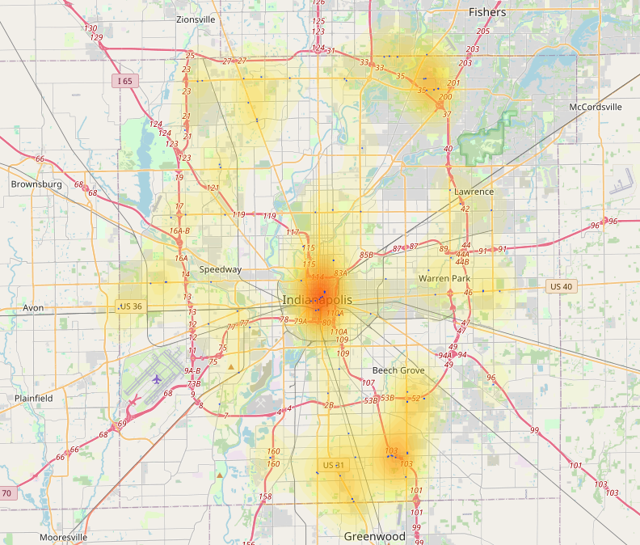
Indianapolis, Indiana
Review
Unit economics
Analytics
Summaries

Slide 16
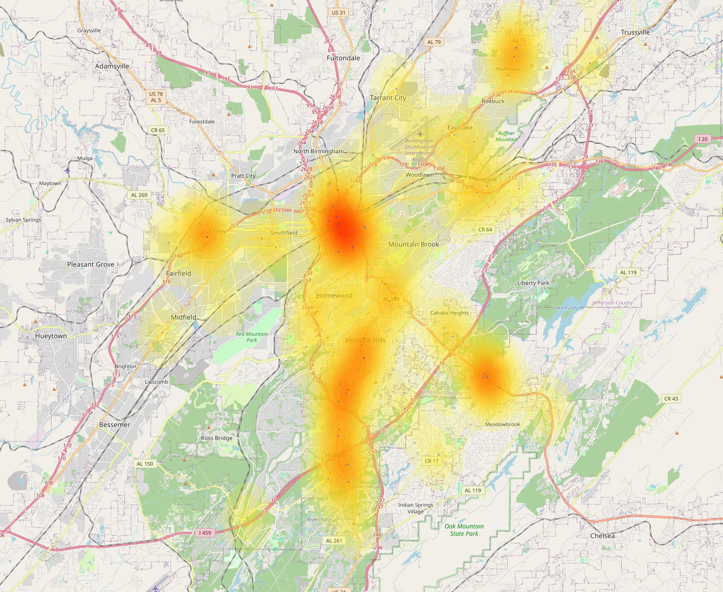
Birmingham, Alabama
Review
Unit economics
Analytics
Summaries

Slide 17
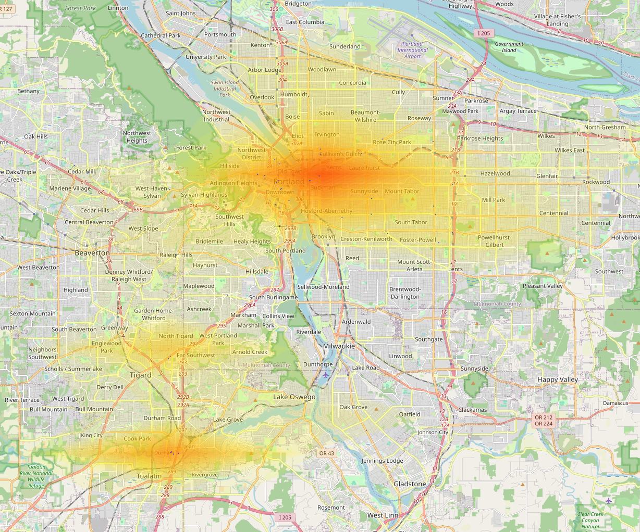
Portland, Oregon
Review
Unit economics
Analytics
Summaries

Slide 19
Юнит экономика
Portland
Review
Indianapolis
Oregon
Ohio
Indiana
Unit economics
Nevada
Cleveland
Columbus
Cincinnati
Alabama
Analytics
Florida
Las Vegas
Summaries
Birmingham
Miami

Slide 21
Аналитика
Portland
Review
Indianapolis
Oregon
Ohio
Indiana
Unit economics
Nevada
Cleveland
Columbus
Cincinnati
Alabama
Analytics
Florida
Las Vegas
Summaries
Birmingham
Miami

Slide 23
Заключение
Portland
Review
Indianapolis
Oregon
Ohio
Indiana
Unit economics
Nevada
Cleveland
Columbus
Cincinnati
Alabama
Analytics
Florida
Las Vegas
Summaries
Birmingham
Miami

